Slide 1

From LaTeX and Pandoc to Accessible Document
2026 Accessibility Summit
Elizabeth J. Pyatt
accessibility@psu.edu

Slide 2
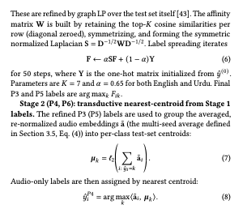
Outline
A. TeX Publication System
  Core markup
  Adding Packages + custom markup
B. Accessibility Conversion Tips
  Tagging and color
C. Pandoc Export

Slide 3
Recommendations Summary
Focus on course materials first
Consider migrating to Word or HTML (via Pandoc)
  Still easier to make an WCAG compliant PDF from Microsoft Office
In LaTeX
  Consider color, accessible links, simple tables, image alt text, long descriptions
Stick to the basics whenever possible
Provide .tex files to accessibility office upon request

Slide 4

Word/HTML vs. PDF
Can you fix typos?
Full editing capabilities
Standardized toolset
Could become a TeX file later on with Pandoc

Slide 5
What is Tex and LaTeX

Slide 6
AMS LaTeX

Slide 7
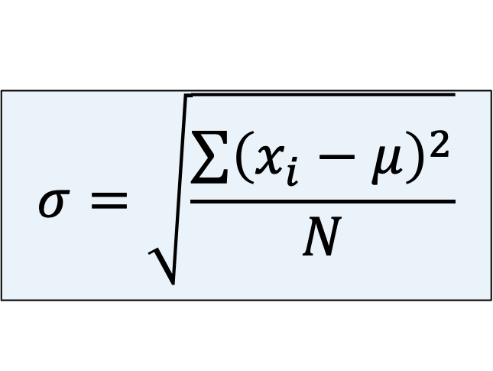
Partial LaTeX for Equations
LaTeX (AMS)
  \sigma=\sqrt{\frac{\sum\left(x_{i}-\mu\right)^{2}}{N}}
  $ \sigma=\sqrt{\frac{\sum\left(x_{i}-\mu\right)^{2}}{N}} $
MathML
  Long HTML Tag string on next slide
$$σ=\sqrt{\frac{\sum{{\left(x_{i}−μ\right)}^{2}}}{N}}$$
Notes:
\sigma=\sqrt{\frac{\sum\left(x_{i}-\mu\right)^{2}}{N}}

Slide 8
MathML Code (Standard Deviation)
HTML/EPUB, Canvas, WordPress, Drupal, Microsoft Word/PPT, ...
Extension of HTML
Unicode Hex Numbers
  &#x2212; is minus sign
  &#x3BC; is Greek μ
  Unicode numbers
    Word & HTML use it
    LaTeX + Unicode still iffy
<math xmlns="http://www.w3.org/1998/Math/MathML" display="block">
<mo>:</mo>
<mi>&#x3C3;</mi>
<mo>=</mo>
<msqrt>
<mfrac>
<mrow>
<mo data-mjx-texclass="OP">&#x2211;</mo>
<msup>
<mrow data-mjx-texclass="INNER">
<mo data-mjx-texclass="OPEN">(</mo>
<msub>
<mi>x</mi>
<mrow data-mjx-texclass="ORD">
<mi>i</mi>
</mrow>
</msub>
<mo>&#x2212;</mo>
<mi>&#x3BC;</mi>
<mo data-mjx-texclass="CLOSE">)</mo>
</mrow>
<mrow data-mjx-texclass="ORD">
<mn>2</mn>
</mrow>
</msup>
</mrow>
<mi>N</mi>
</mfrac>
</msqrt>
</math>

Slide 9
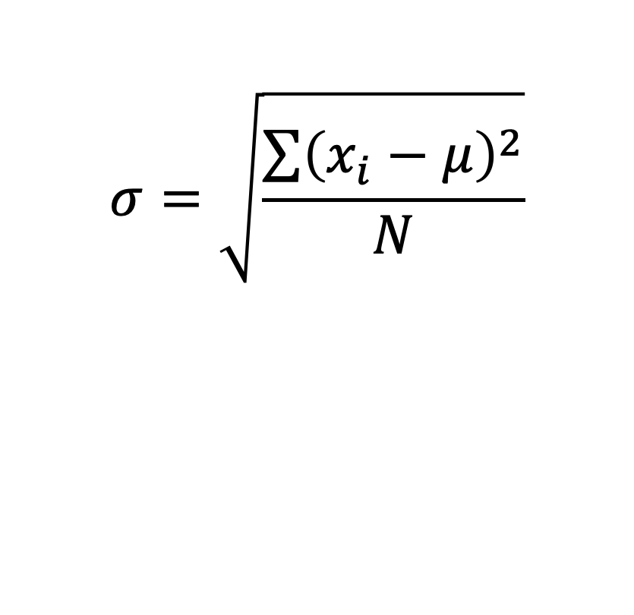
AMS LaTeX Insertion → MathML
Word, PowerPoint, Canvas, etc.
Live Demo
  \sigma=\sqrt{\frac{\sum\left(x_{i}-\mu\right)^{2}}{N}}
$$σ=\sqrt{\frac{\sum{{\left(x_{i}−μ\right)}^{2}}}{N}}$$
Notes:
\sigma=\sqrt{\frac{\sum\left(x_{i}-\mu\right)^{2}}{N}}

Slide 10
Tex: Beyond Equations

Slide 11
TeX and LaTeX
Long-Standing Open Source Publishing System
  Source files are plain text .tex files with commands and mark up
  LaTeX tool converts/compiles .tex files to PDF or HTML/RTF
  “Packages” extend functionality (e.g. AMSMath, Tikz,...)
HTML Analogue
  .html files are rendered as web pages in a browser
  Can be extended with MathML, Javascript...

Slide 12
Demo: LaTeX Compile PDF

Slide 13
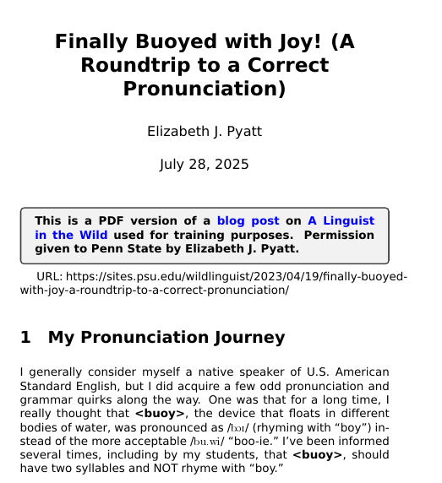
Example TeX Preamble
Text from “Buoyed with Joy”
\documentclass[12pt]{article}
\usepackage{arev}
\usepackage[svgnames]{xcolor}
\usepackage[colorlinks=true, urlcolor=blue, linkcolor=red]{hyperref}
\usepackage{graphicx}
\usepackage{tcolorbox}
% Title + H1 Here
\title{\textbf{Finally Buoyed with Joy! (A Roundtrip to a Correct Pronunciation)}}
\date{July 28, 2025}
\author{Elizabeth J. Pyatt}
\setlength{\parskip}{6pt}

Slide 14
Body and Visual Headings
% The BODY of the content.
\begin{document}
% Cp[y title from preamble. It will be large.
\maketitle
\pagenumbering{arabic}
\begin{tcolorbox}
...
\end{tcolorbox}
URL: https://sites.psu.edu/wildlinguist/2023/04/19/finally-buoyed-with-joy-a-roundtrip-to-a-correct-pronunciation/
\section{My Pronunciation Journey=H2 candidate}
...
\subsection{Text=H3 Candidate}
\subsubsection{Text=H4 Candidate}
\end{document}

Slide 15
LaTex Compliers & Packages
Some Compilers
  MikTex.org, TeXLive (Windows/Mac as “MacTeX”)
    Standalone
    Begin with “Light” or “Easy” install
  Overleaf.com (Online with account)
    Based on TeXLive. Free version available, but with compiling limits
    Excellent tutorials
  Others...
Package Repository
  CTAN (fonts and packages), Others...

Slide 16
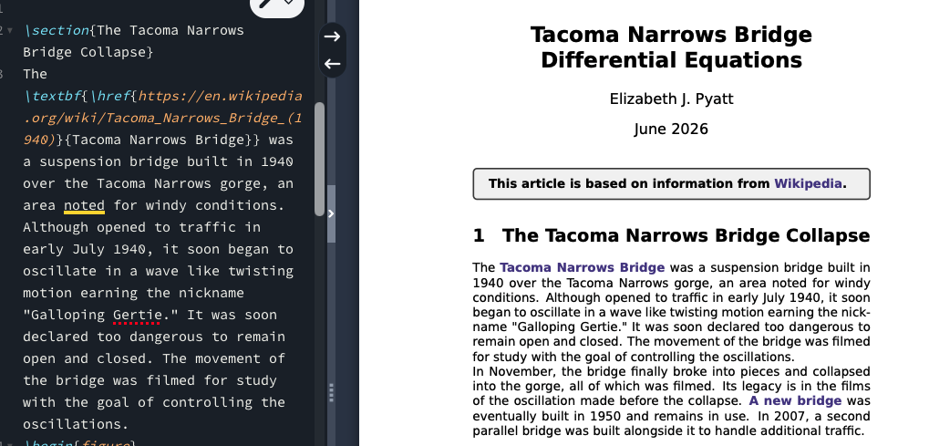
Example: Tacoma Narrows Bridge
Overleaf
\section {} = Main Topic
\textbf{} =
bold face
\href[URL]{}
=link text

Slide 17
What kinds of Packages?
Basic
Specialty
amsmath – enables LaTex math
graphicsx – embed images
hyperref – add links
colorx – color names
tcolorbox – borders and shading
arev – use Arev Sans font
beamer – LaTex slides
TikZ – draw lines and shapes
Pgfplots – create graphs from data
BibTex – manage reference list
tipa – insert phonetic symbols
forest – syntax and other trees
celtic – Celtic knots
guitartabs – for guitarists
CTAN Chemistry
CTAN Linguistics
CTAN Music
All Topics

Slide 18
Implications of Packages
Some packages widely used
  But others very customized or used within niche disciplines
Experienced LaTeX authors can create macros, custom symbols and other variations
More diverse code base than HTML or Office XML

Slide 19
Accessibility Improvements

Slide 20
WCAG vs. PDF/UA-2
WCAG 2.2 covers
  Tagging, color use, keyboard functionality, ...
  Mandated across governments, academia internationally
PDF/UA-2
  Tagging only – headings, tables, lists, alt text,...
    BUT MathML + Unicode included
  No color guidelines
  Conflicts with WCAG
Color in many charts and graphs

Slide 21
General Recommendations
Use list tools /itemize and /enumerate
  Decimal lists (e.g. 1.1.x) are accessible
For links, add bolding and/or underlining
Math – Add low level headings for equations
  /paragraph{Equation 1}
  Autonumbering is OK too

Slide 22
Headings
PDF/UA-2 vs. WCAG

Slide 23
LaTeX Heading Levels (Overleaf Sections)
\title{} and \maketitle
If doc is a book, then \chapter{} + sections
If doc is an article, then
  \section{} (1)
  \subsection{} (1.1)
  \subsubsection{} (1.1.1)
  \paragraph{} – treated as a heading, but below object
  \subaragraph{}
\tableofcontents - creates a TOC
\usepackage{titlesec} – stylize and renumber headings

Slide 24
Tagged PDF Headings War?
WCAG (W3C) &
DSO Office
LaTex
PDF/UA-2 &
Earlier Microsoft
H1 = Title
H2 = Main Topic
H3...H6 = Sub Topics
\maketitle{}
\section{}
\subsection{}
\subsubsection{}
“Title” = Title
H1 = Main Topic
H2...H6 = Sub Topics
HTML
PDF

Slide 25
Headings Recommendation
Penn State
  Use WCAG per policy and precedent
    Pubcom mentions screen reader support issues
  Changing Heading Levels?
    Adobe Acrobat Tag Tree (manually) or
    Pandoc to Word/HTML (automated)

Slide 26
Tables

Slide 27
Bare Minimum for Tables
Do NOT merge cells.
Label all columns and rows (headers)
  No blank upper left cells. Can throw off screen readers.
  “Item” or “Parameter” is a good default.
  Many screen readers can compensate if table meets
  conditions 1 and 2.
Add a \caption or \subsubsection label for the table above the data.
Fix in Word or HTML as needed.

Slide 28
LaTeX Packages (Overleaf Tables)
\tabular, \tabularx, \longtable, \array, others?
  Arrays in AMS LaTeX are modeled on tables.
  \usepackage[table]{xcolor} – so you can add colors to tables
Sample Markup
  \begin{table}[h!] – table div here for captions, data, etc.
  \begin{tabular}{|r|c|l|} – three cols, with vertical lines, right, center & left aligned
  & - cell separator
  \\ end line
  \hline – visible horizontal line between rows
  \rowcolor, \columncolor, \cellcolor as needed

Slide 29
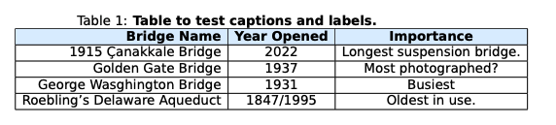
Example Table
\begin{table}[h!]
\caption{\textbf{Table to test captions and labels.}}
\begin{tabular}{ |r|c|c|}
\hline
\rowcolor[HTML]{DDEEFF}
\textbf{Bridge Name} & \textbf{Year Opened} & \textbf{Importance}\\
\hline
1915 Çanakkale Bridge & 2022 & Longest suspension bridge. \\
\hline
Golden Gate Bridge& 1937 & Most photographed?\\
\hline
George Wasghington Bridge & 1931 & Busiest\\
\hline
Roebling's Delaware Aqueduct & 1847/1995 & Oldest in use.\\
\hline
\end{tabular}
\end{table}

Slide 30
Bonus Word Table Demo
With Word Table Styles
And Convert Text to Tables
Bridge Year Opened Crossing Location Why it Matters
1915 Çanakkale Bridge 2022 Cross Dardanelles in Turkey Longest suspension Bridge
Golden Gate Bridge 1937 Crosses "Golden Gate" opening in San Francisco Bay "Golden Gate" passage in San Francisco Bay Most photographed?
George Washington Bridge 1931 Crosses Hudson River to Manhattan Busiest suspension bridge
Roebling's Delaware Aqueduct 1847, renovated in 1995 Crosses Delaware & Hudson River Oldest U.S. suspension bridge still in use

Slide 31
Image Alt Text...in LaTeX
graphicsx Required

Slide 32
graphicsx Package
DON’T set a directory if possible
  Images should be in same folder as .tex file for Pandoc
Can add ALT text and make size adjustments.
About graphicsx

Slide 33
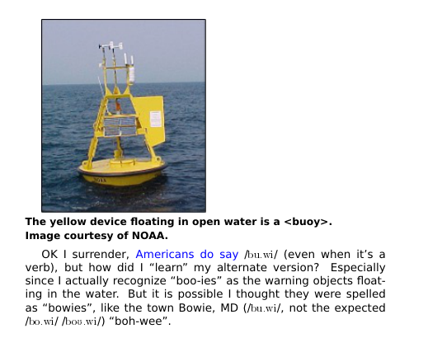
Add ALT Text (for Pandoc)
\includegraphics[alt={yellow buoy with rounded bottom on open water}]{NOAA-buoy}
\\ {\small \textbf{The yellow device floating in open water is a <buoy>.
\\Image courtesy of NOAA.}}

Slide 34
Diagrams and
Long Descriptions

Slide 35
Bare Minimum for Charts
Add “long descriptions” in .tex file.
  Can be explanations in the caption or in the text that are seen by everyone
Make visible to the sighted.
  Not everyone understands diagrams the same way
Use accessible colors in charts
  Sufficient contrast and usable in black and white

Slide 36
Long Description Parts
Type of image
  Line chart, tree diagram, circuit diagram, bar chart, molecule...
Key components
  Can skip other parts
Ensure that embedded text is identified
  Chart titles, annotations, keys, scales

Slide 37
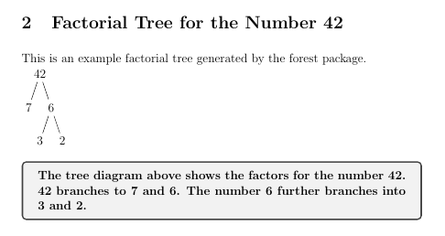
Example Tree Diagram
With Long Description Below
Uses the forest package
  No alt text available
  But underlying text may be read out on a screen reader
Code
  \begin{forest}
  [42 [7][6 [3][2]]]
  \end{forest}

Slide 38
WCAG Compliant
Keep Long Description Below
Compile forest code in separate doc
Extract image
  Simple screen cap
  SVG or EPS if possible
Embed with graphicsx package with ALT attribute.
Keep long description

Slide 39
LaTeX Packages for Images
General
graphicsx
colorx
tickz (mother ship)
Pgfplots
Specific
forest (tree diagrams)
CTAN Chemistry

Slide 40
Color

Slide 41
Limited Color Palette
Default too limited
Default
  Red, *blue, green, yellow, cyan, magenta, *black,
  Only *colors pass contrast guidelines with white
Can add to list of colors

Slide 42
xcolor Package Option
\usepackage[svgnames]{xcolor}
  Expanded Color Names
  Includes “Alice Blue” and “Navy”
\usepackage[dvipsnames]{xcolor}
  \definecolor{crimsonX}{HTML}{CC0000}
  \definecolor{navyX}{HTML}{000099}
  Can define via RGB or CYMK as needed
Full xcolor documentation (PDF)
  Documents custom color mixes. See also Overleaf Color

Slide 43
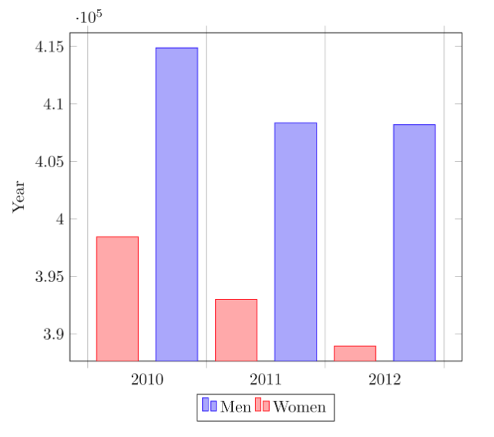
Tikz Bar Graph (Overleaf)
\begin{tikzpicture}
\begin{axis}[
x tick label style={
/pgf/number format/1000 sep=},
ylabel=Year,
enlargelimits=0.05,
legend style={at={(0.5,-0.1)},
anchor=north,legend columns=-1},
ybar interval=0.7,
]
\addplot
coordinates {(2012,408184) (2011,408348)
(2010,414870) (2009,412156)};
\addplot
coordinates {(2012,388950) (2011,393007)
(2010,398449) (2009,395972)};
\legend{Men,Women}
\end{axis}
\end{tikzpicture}

Slide 44
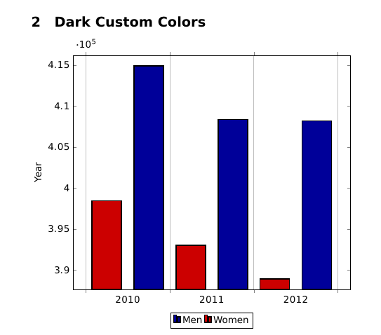
Bar Graph Accessibility
Mind color contrast
  Make sure text is black
  Used custom colors with colorx package
    navyX and crimsonX
      addplot[fill=navyX,line width=1.5pt]
Add data table below

Slide 45
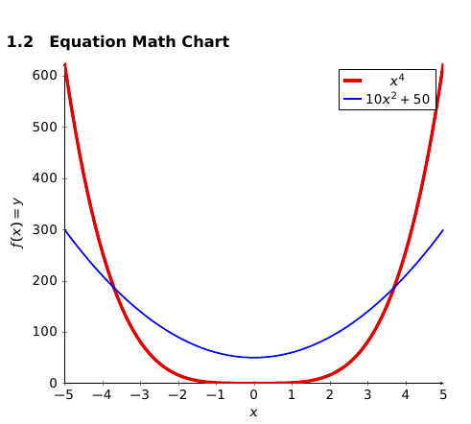
PGF Plots
Converts text to graphs
Check for contrast, grayscale
Can export as EPS as needed
  \addplot [
  domain=-5:5,
  samples=100,
  color=red!90!black,
  line width=3pt,
  ]
  {x^4};

Slide 46
Enter Pandoc
Command Line Interface

Slide 47
Installation
Installation: www.pandoc.org (Installation)
  PowerShell (Win) or Terminal (Mac) required
Online Form: pandoc.org/try
Is it installed?
  pandoc --version (retrieves version number)
Text Tips
  Avoid spaces in folder and file names.
    Dashes, dots, underscores OK
  Assume case sensitivity (LaTeX ≠ latex ≠ Latex ≠ LATEX)
  Avoid smart quotes (“”) Use "" instead.

Slide 48
Command Line Interfaces
Windows – Power Shell or other command prompt
  Similar to MS-DOS
Mac – Terminal (Unix)
  Many STEM faculty are on a Mac
Linux
  Multiple options
See Pandoc Get Started

Slide 49

LaTeX Math to MathML (Dr. Drang)
Example Live Conversion
pandoc --mathml <<<'$$T = \frac{1}{2} v_x^2$$'
  Recommend composing commands in text editor
  No smart quotes allowed
$$T=\frac{1}{2}v_{x}^{2}$$

Slide 50
Directory Navigation
Function | Windows | Mac
Directory (folder) path slash | \ | /
Change directory | cd | cd
Move up one level | ..\ | ../
List files | dir | ls
Demo Directory (Mac) |  | LaTeX/TacomaBridge

Slide 51
Tex File → HTML 5 + MathML
pandoc foo.tex -V lang=en -f latex -t html -s --mathml -o foo.html
Useful options
  pandoc Buoyed-Joy-L1-ALT.tex --css=mcss.css -V lang=en -f latex -t html -s --mathml -o Buoyed-Joy-L1-ALT.html --shift-heading-level-by=1
  Add Custom CSS
  Shift heading down 1

Slide 52
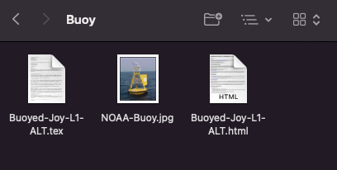
Using images?
Place in same directory as .tex file (i.e. not in an /images folder)
Pandoc can navigate inside a directory

Slide 53
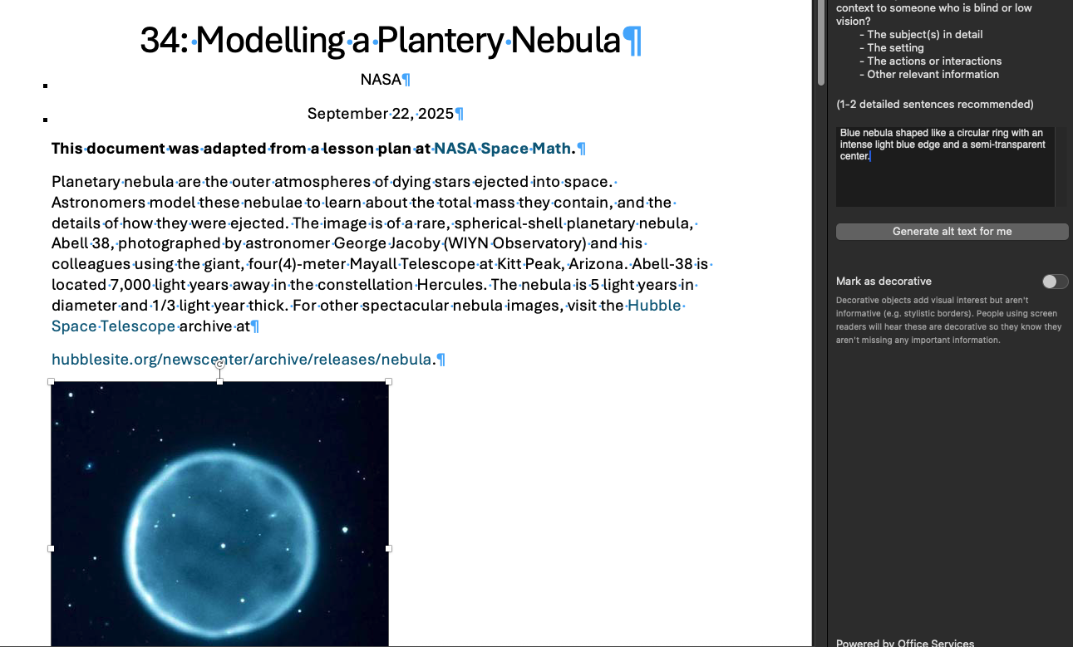
Also Word
pandoc NASA.tex -V lang=en -f latex -t docx -s --mathml -o NASA.docx --shift-heading-level-by=1

Slide 54
Customize Word Styles
Option 1
  Migrate Styles via Organizer
Option 2
  Create blank Word file named custom-template.docx
  Modify Heading and Normal styles
    See accessibility.psu.edu/tips for details
  Place in same directory as input file.
    Or use Unix style absolute reference/alias
  Add --reference-doc=custom-template.docx to end of command
    pandoc foo.tex -V lang=en -f latex -t docx -s --mathml -o foo.docx --shift-heading-level-by=1 --reference-doc=custom-template.docx

Slide 55
My Current Word Template
Revised Headings
Revised Caption, Bibliography
Box styles
Phonetics, keyboard commands, ....
All with keyboard equivalent commands

Slide 56
Beamer to PowerPoint (One Way)
Each \frame{} is a slide BUT Pandoc skips.
Add a \section{} as a slide title.
  Won’t appear in PDF
Reference PPT requires certain layouts (errors will tell you which are missing)
Pandoc command
  pandoc foo.tex -V lang=en -f latex -t pptx -s --mathml -o foo.pptx --reference-doc=MyBeamer.pptx

Slide 57
Word with Images to HTML
pandoc foo.docx -V lang=en -f docx -t html -s --mathml -o foo.html --extract-media=fooimg/
  --extract media folder must exist
  Few Microsoft artifacts
  CSS added, but can be overridden
  Headings are WCAG levels
  Only column table headers

Slide 58
Questions?

Slide 59
Appendix
Slides not in the final Video

Slide 60
Cons and Pros of LaTeX
Cons
  Almost all PDFs are untagged
  Unicode for math and phonetics is very difficult
    Can result in things like β reading as “b” on screen reader
    TIPA: /@/ → /ə/
Pros
  Free open source, large user base
  With free fonts like Arev Sans, STIX,...
  Structure is available in .tex
  Lots of functionality – can it be leveraged?

Slide 61
Lists

Slide 62
Bare Minimum for Lists
  Use the LaTeX lists (\itemize and \enumerate)
  For numbered lists, switch numbering conventions between levels.
    Level 1
      Level 2 (1.1 or Roman numerals also work)

Slide 63
Embedding Math

Slide 64
AMS Math (Overleaf Equations)
Packages –
  \usepackage{amsmath} and amssym, amsfonts
Inline (inside paragraph)
  $$ or other delimiter
    $e=mc^2$ or $\omega$
Display (own paragraph), with auto numbering
  \begin{equation}...\end{equation}

Slide 65
Additional Comments
Recommend adding a low level heading for numbers, labels
  \subsubsection{Equation 1}
Agnostic on serif vs. sans-serif
  Sans serif is very legible, but not italics sans serif
  Serif italics may be better.
  Serif is helpful for Greek letters (α,δ,ν,ι vs. α,δ,ν,ι)

Slide 66
Link Text

Slide 67
hyperref Package
Use hyperref package for in-text links
  Set color name to one with good contrast (blue is OK)
Embed in bold face and/or add underline
Check – how permanent is the link?
  DOI links may be permanent

Slide 68
Example Link
Add package – \usepackage{hyperref}
Make the link
  \href{https://en.Wikipedia.org/wiki/Tacoma_Narrows_Bridge_(1940)}{Tacoma Narrows Bridge}
Make it bold
  \textbf{}
    \textbf{\href{https://en.Wikipedia.org/wiki/Tacoma_Narrows_Bridge_(1940)}{Tacoma Narrows Bridge}}
Underline = \underline{}

