Slide 1

February 5, 2020

Slide 2

VISION
Recruitment/enrollment
Student success
Telling our story
Positioning ourselves for the future

Slide 3
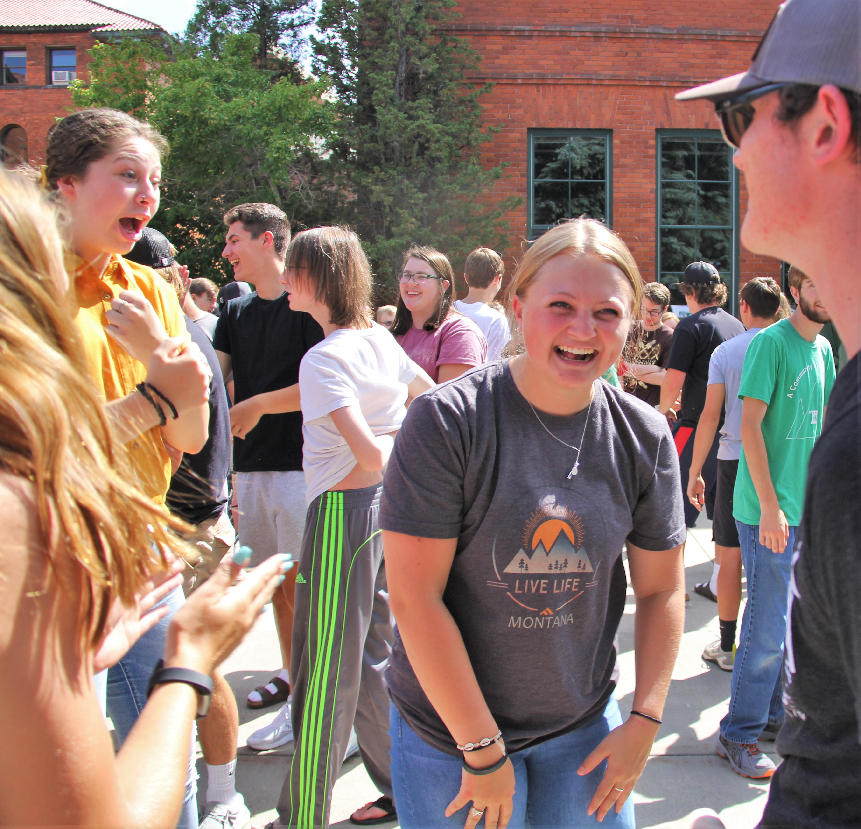
Admissions Updates

Slide 4
Fall 2020 Applications
Graduate School
Transfer Students (IN & OUT of State)
In-State Freshman
Highlands College

Slide 5
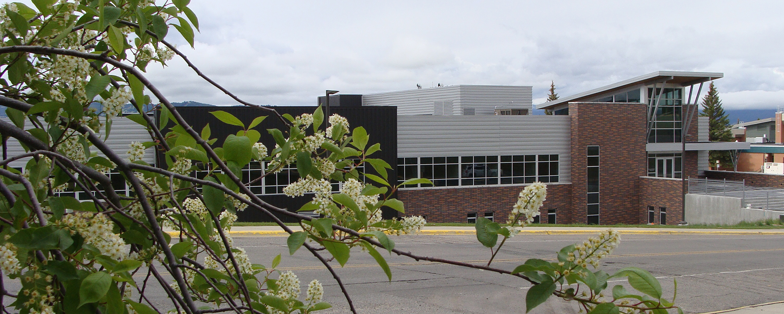
Campus Visits
100%
Favorite Part of Visit:
“The conversations with faculty was very helpful and enjoyable.”
Students & parents can see themselves attending Montana Tech.
“Jocelyn the housing rep really made Tech feel like such a good place.”
“That the staff and tour guides are very motivating and reassuring.”
“Meeting with Amy Lorang.”

Slide 6

SAVE THE DATES APRIL 2-3 2020

Slide 7

STUDENT SUCCESS

Slide 8
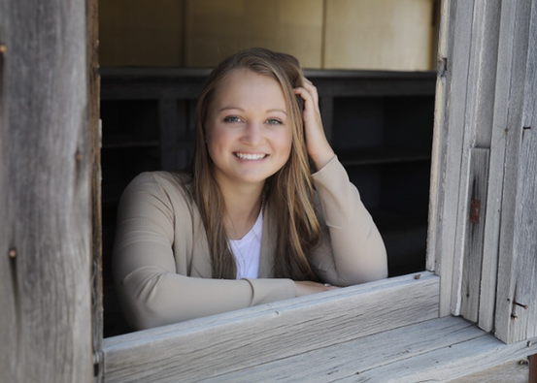
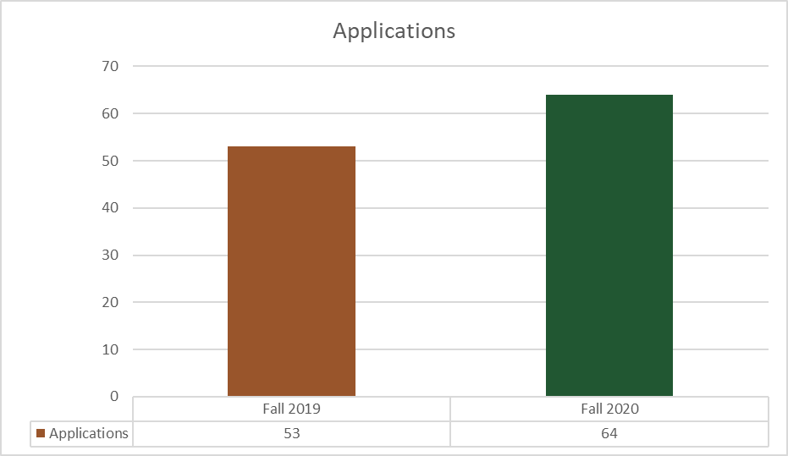
Honors Program
"Being part of the honors program at Tech is awesome! I didn’t know what to expect when I first applied, but I am so glad I did. Since joining, I have gotten to know a few faculty members and become friends with the other students in the cohort. It’s nice to recognize other faces on campus and be able to say hello! Not only that, but getting to participate in the group discussions and activities is a nice break from the traditional lectures I have in my other classes. If you have the opportunity to apply, I would highly recommend it!"
Jaden Cleveland, F19 Cohort, Freshman, Civil Engineering, Butte, MT

Slide 9
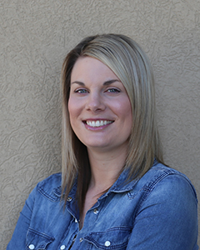
Retention Efforts
Freshman Engineering Professional Advisor
Fall 2019: 143 students; 315 visits
Advising Satisfaction Survey (61% Response rate (N=93)
90%
would recommend their advisor to another student.
90%
believe advisor is spending enough time to help them with their concerns.
95%
pleased or extremely pleased with the overall advising experience

Slide 10
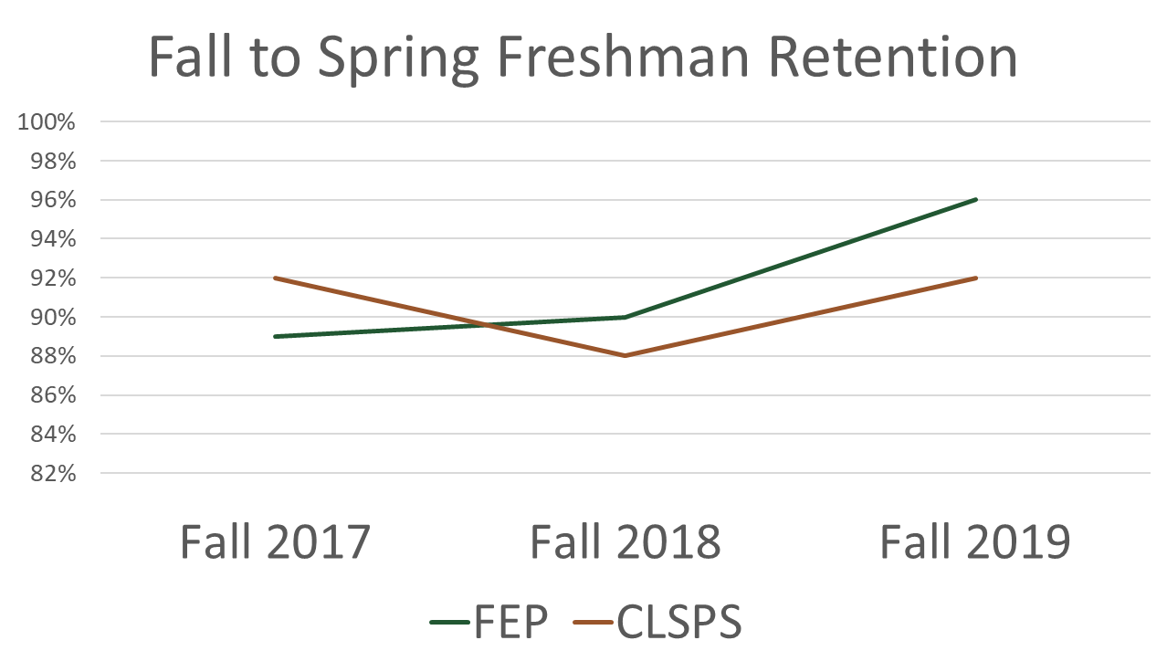
Retention Efforts

Slide 11


Spring 2020 Enrollment
Enrollment is down because Fall 2019
was down.
Fall to Spring Retention is UP- this was higher than we projected!!!

Slide 12

Brand Research & Campaign
WELCOME

Slide 13

PROJECT OVERVIEW
Phase I: (complete)
  Qualitative Research
  Market Analysis
  Quantitative Research
Phase II:
  Brand Clarification
  Brand Creative
  Brand Communication Planning

Slide 14
PHASE I: KEY FINDINGS
Tell our story more – removing the institutional voice
Focus on the benefits, not the features
Cost of attendance and academic programs/quality are driving factors in getting students to Montana Tech
Important to prospective students: quality of intended major, availability of scholarships/financial aid, overall value of the education, graduates get good jobs
Core strengths from all audiences surveyed: graduates get good jobs in their field, overall academic reputation, employers value a degree from Montana Tech, access to outdoor activities, overall value

Slide 15

WHAT’S NEXT
Develop a brand promise and pillars
Share with campus at the next forum

Slide 16

Finance

Slide 17
Montana Technological University
Current Unrestricted
REVENUE | FY16 | FY17 | FY18 | FY19 | FY20 Budget
State Support | $15,484,533 | $15,924,638 | $15,171,959 | $15,244,296 | $15,526,238
Net Tuition Revenue | $15,831,243 | $15,829,411 | $14,134,868 | $13,679,992 | $13,013,974
Transfers/Other | $655,532 | $624,769 | $849,005 | $866,522 | $882,155
Total Operating Revenue | $31,971,308 | $32,378,818 | $30,155,832 | $29,790,810 | $29,422,367
Scholarships/Discounts/Waivers | $2,415,526 | $2,418,527 | $2,443,473 | $2,623,508 | $2,613,628
Special Approps/OTO/MUS-RP | $602,228 | $108,550 | $117,937 | $117,491 | $118,000
Total Current Unrestricted | $34,989,062 | $34,905,895 | $32,717,242 | $32,531,809 | $32,153,995
 |  |  |  | Tution Revenue Shortfall | 783,959
 |  |  |  | FY 20 TOTAL | $31,370,036
Student FTE | 2,617 | 2,510 | 2,309 | 2,178 | 2,150
Resident Students | 1,942 | 1,812 | 1,732 | 1,644 | 1,665
Non-resident Students | 675 | 698 | 577 | 535 | 485

Slide 18
FY 20 Tuition Revenue
 | Budget | As of 2/4/20 | Difference
Summer 2019 | 1,003,924 | 1,007,921 | 3,997
Fall 2019 | 7,751,108 | 7,298,520 | (452,588)
Spring 2020 | 6,832,272 | 6,496,904 | (335,368)
TOTAL | 15,587,304 | 14,803,345 | (783,959)
Spring revenue is coming in at 89% of Fall. Not final yet.
 | Shortfall as of 2/4/20 | (783,959)
 | Budgeted Shortfall | 253,178
 |  | (530,781)

Slide 19
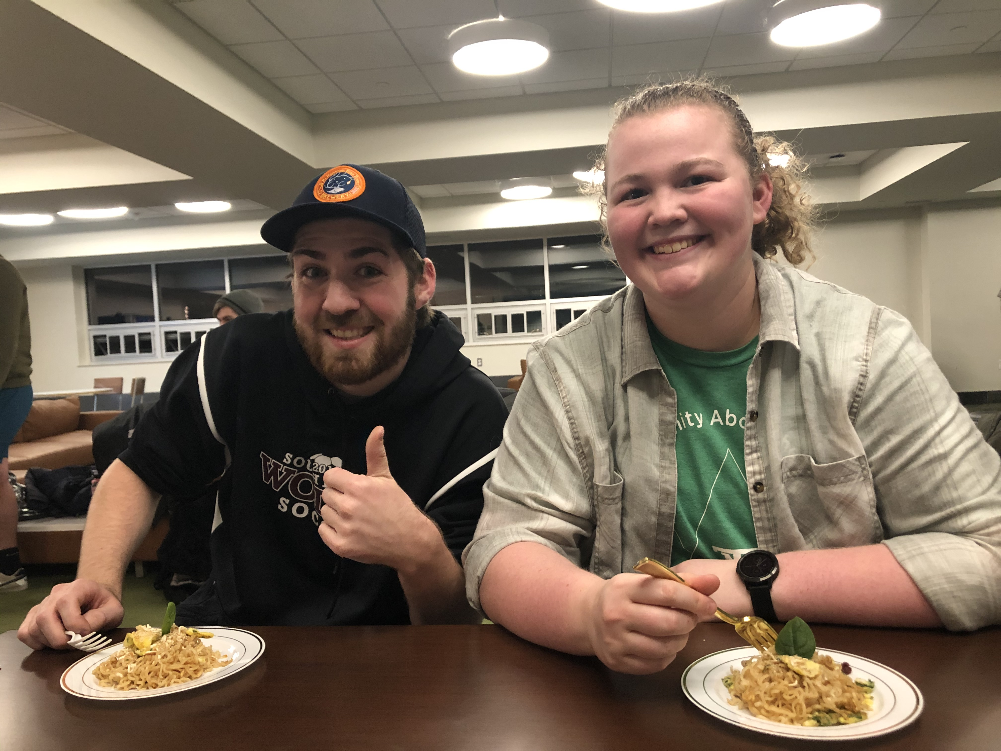
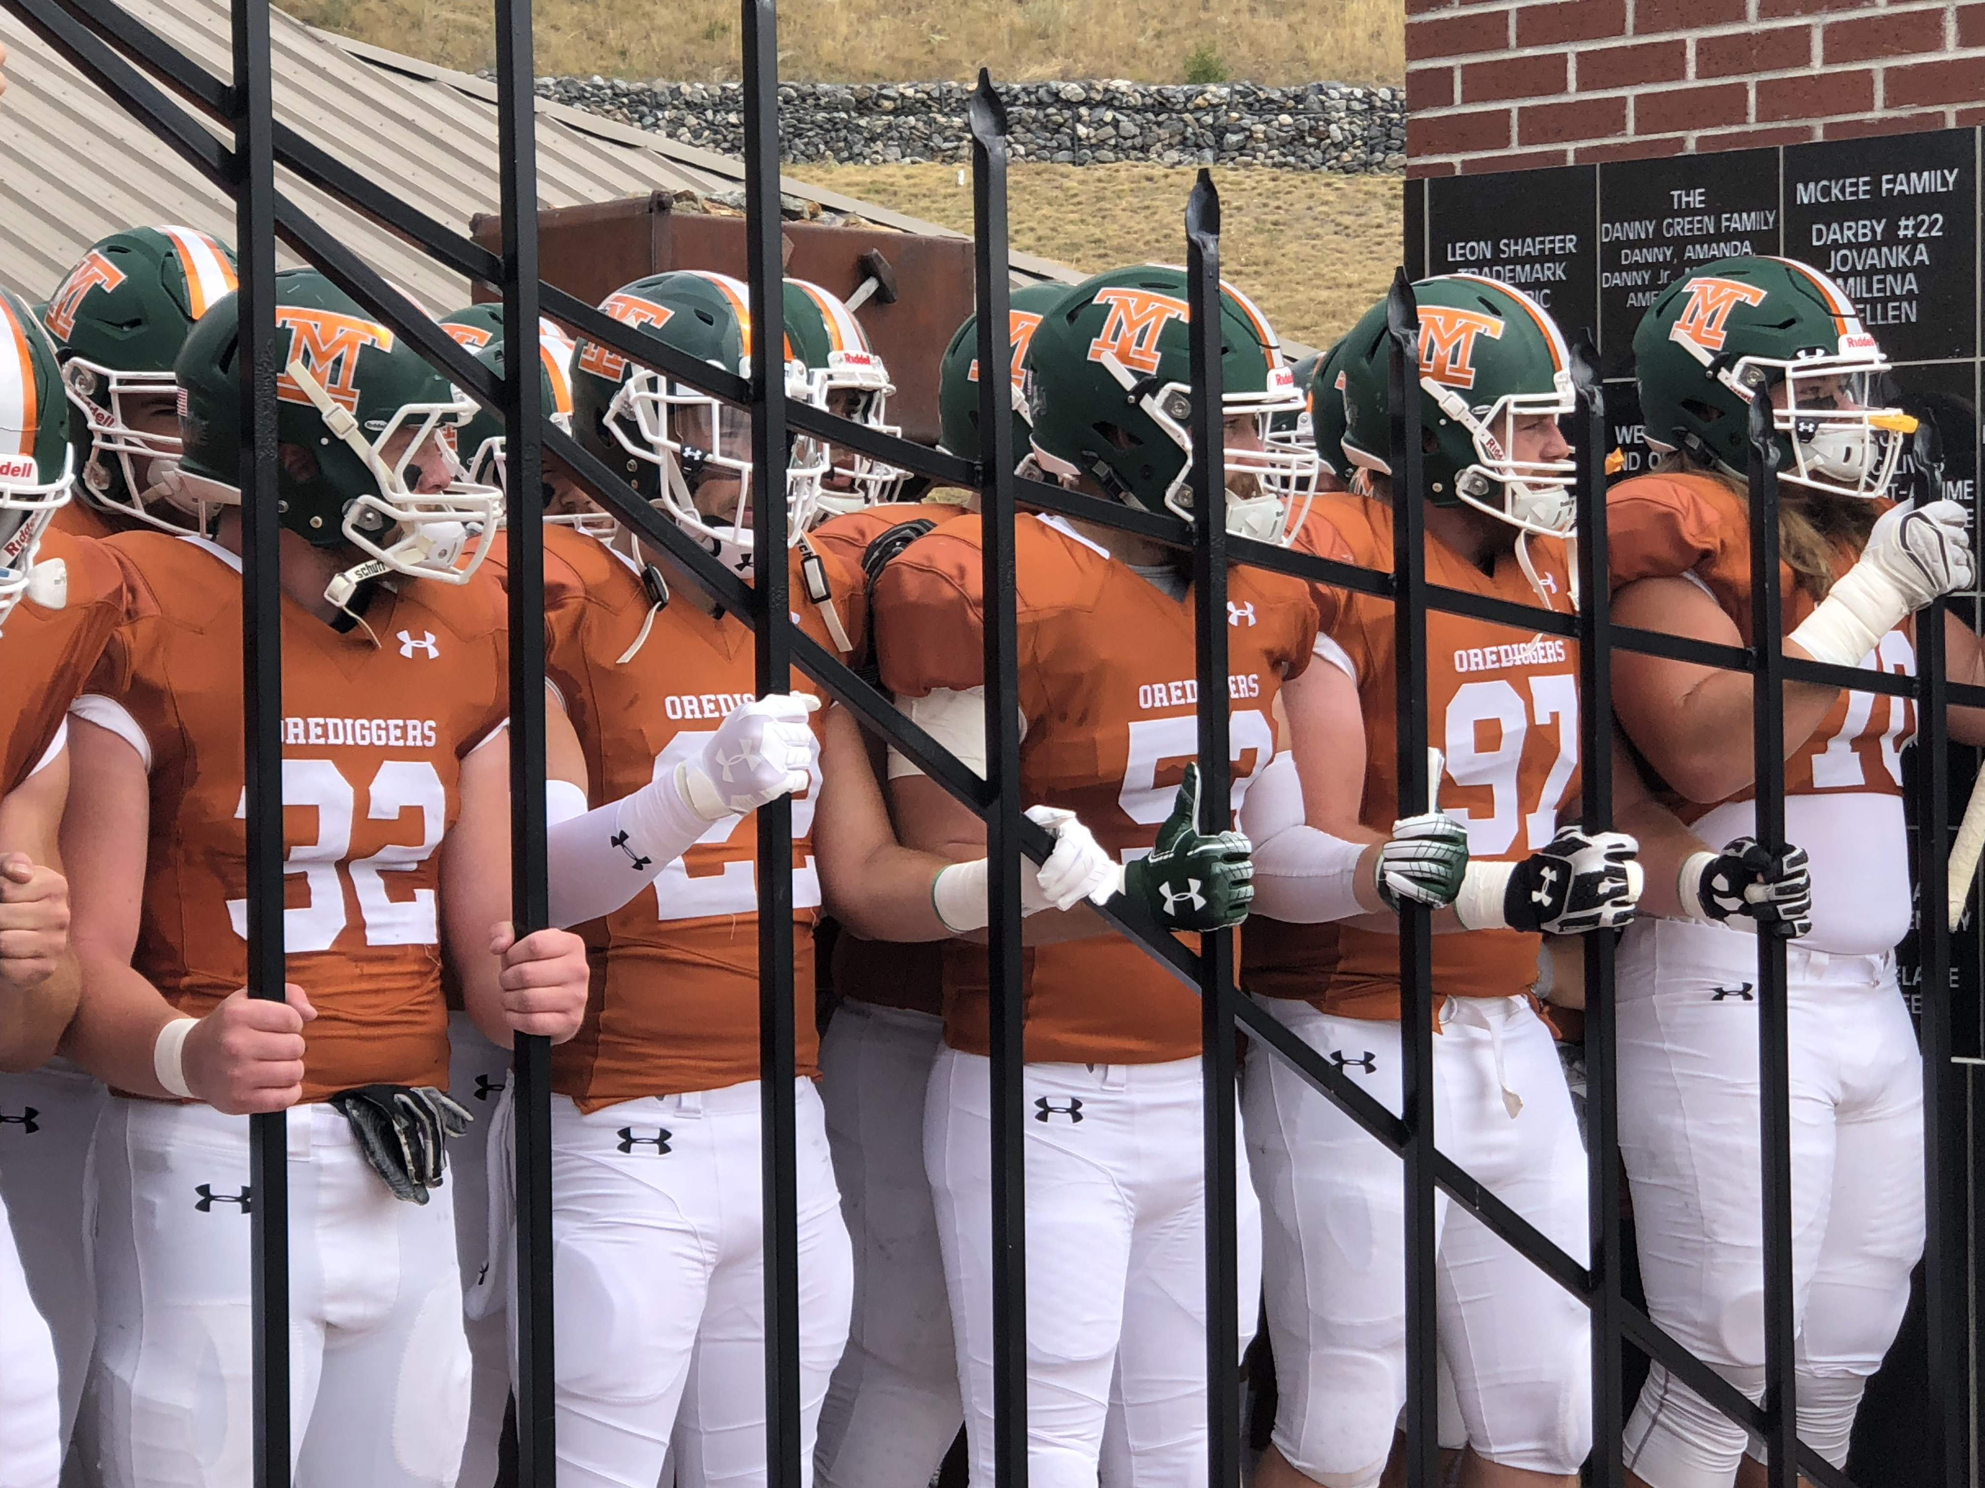
WHAT DOES SUCCESS LOOK LIKE?
Robust enrollment structure & plan in place
Student success/increased retention
High impact marketing/branding campaign developed and deployed
Provost and VC Administration & Finance searches completed
Successful ABET accreditation visit and Northwest Commission mid-cycle review
Approval of two new PhD programs
Funding secured and plans implemented for Nursing Simulation Center
Fiscally sound/balanced budget
Clear and consistent campus communication
Completion of campus space audit with progressive/action driven recommendations

Slide 20
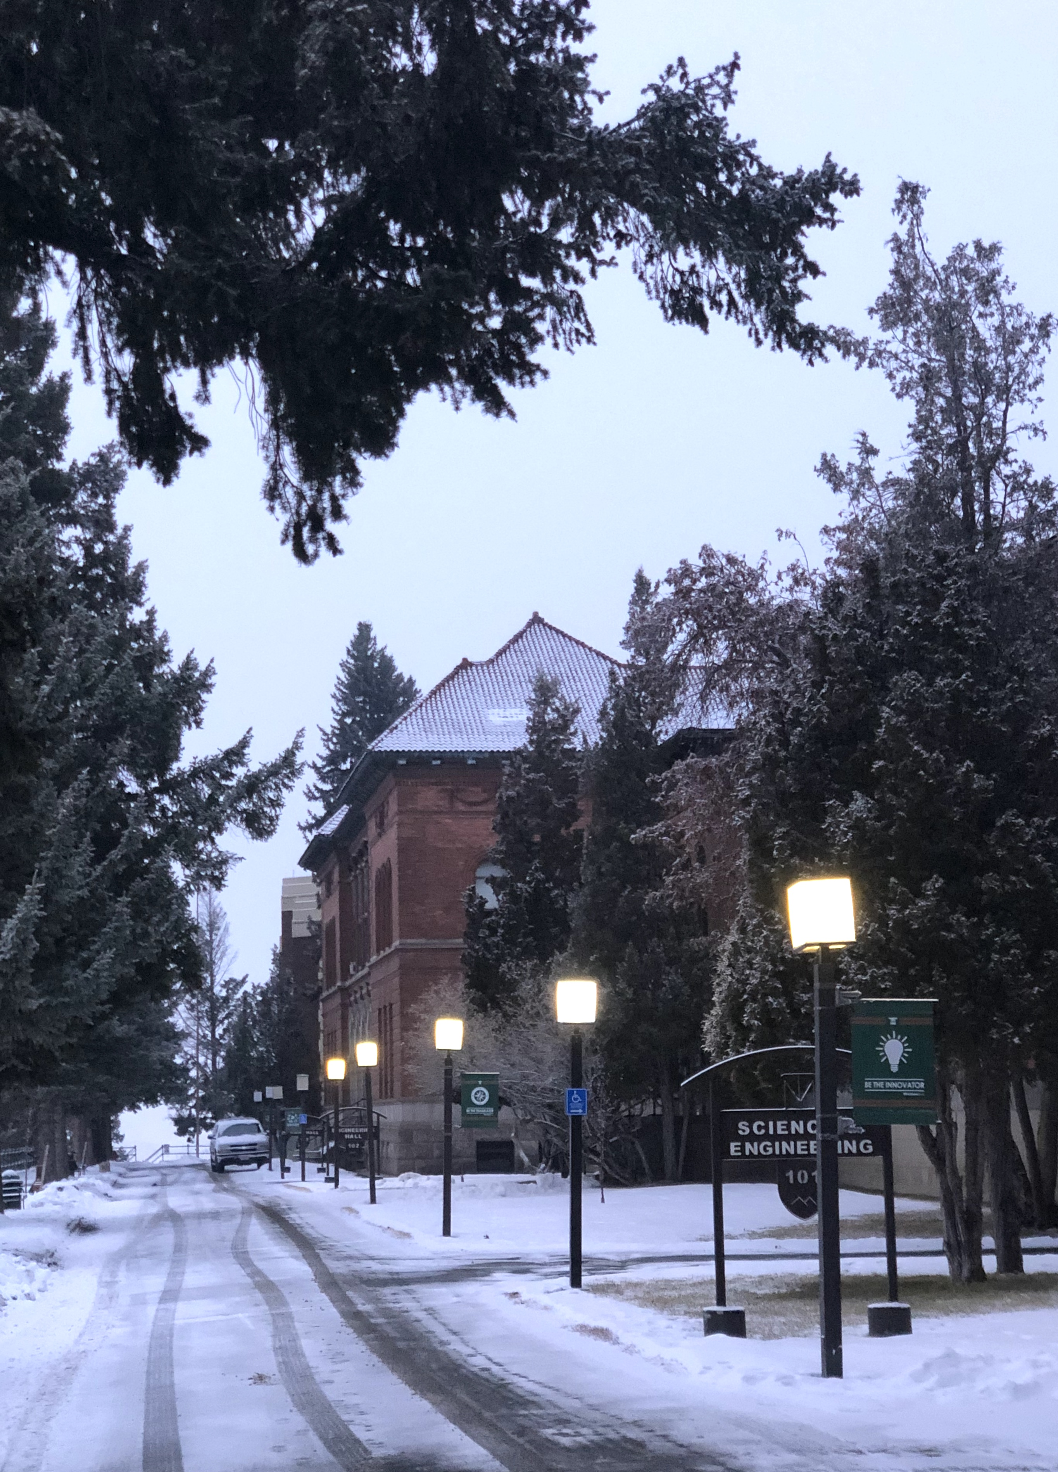
ANNOUNCEMENTS
Board of Regents|March 5-6
Springbreak|March 14-22
DiggerCon 2020|April 2-3
Employee Service Awards|April 16
Petroleum Symposium|April 16-17
Digger Auction|April 18
Techxpo|April 23
Accreditation Mid-cycle Review|April 30-May 1
Commencement|May 2

Slide 21
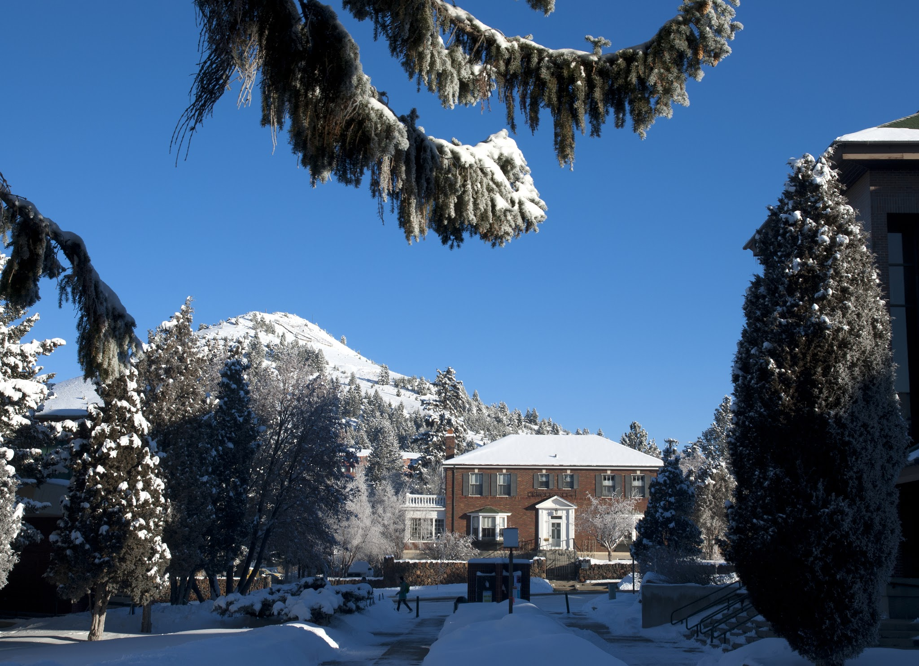
THANK YOU

